Slide 1
Performance testing
14/03/2024

Slide 2



About Me
Test Automation Architect
Ilias Rentifis
Bachelor in Computer Science, University of Crete
MSc in Science and Technology of Electrical and Computer Engineering,
University of Thessaly
Unit Testing
Functional Testing
End to End Testing
Service Testing
Load Testing
Stress Testing
Integration Testing
Telecommunications
Banking sector
Travel sector
European projects
Lead a team of ~ 40 automation engineers in test.
Study automated controls architecture solutions.

Slide 3
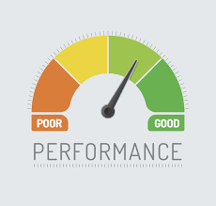

Mission-critical applications like space launch programs or life-saving medical equipment should be performance tested to ensure that they run for a long period without deviations
It’s estimated that companies lost sales worth $1100 per second due to a recent Amazon Web Service Outage.
What is Performance testing?
Testing to determine the performance efficiency of a component or system.
Only a 5-minute downtime of Google.com (19-Aug-13) is estimated to cost the search giant as much as $545,000.
10 seconds is about the limit for keeping the user's attention focused on the dialogue.

Slide 4
Why performance testing?
It’s estimated that companies lost sales worth $1100 per second due to a recent Amazon Web Service Outage.
Mission-critical applications like space launch programs or life-saving medical equipment should be performance tested to ensure that they run for a long period without deviations
Only a 5-minute downtime of Google.com (19-Aug-13) is estimated to cost the search giant as much as $545,000.
10 seconds is about the limit for keeping the user's attention focused on the dialogue.

Slide 5
Mission-critical applications like space launch programs or life-saving medical equipment should be performance tested to ensure that they run for a long period without deviations
It’s estimated that companies lost sales worth $1100 per second due to a recent Amazon Web Service Outage.
What can be achieved with performance testing?
Identification of bottlenecks
Identification of major code defects
Identification of architectural issues
Clarity on resource utilization
Improved quality from a user’s perspective
Guaranteed customer satisfaction
Only a 5-minute downtime of Google.com (19-Aug-13) is estimated to cost the search giant as much as $545,000.
10 seconds is about the limit for keeping the user's attention focused on the dialogue.

Slide 6

Performance testing types
Identification of bottlenecks
Identification of major code defects
Identification of architectural issues
Clarity on resource utilization
Improved quality from a user’s perspective
Guaranteed customer satisfaction
Stress Testing
Scalability Testing
Spike Testing
Endurance Testing
Concurrency Testing
Capacity Testing
Load Testing

Slide 7
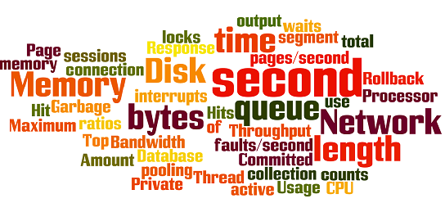

Performance testing metrics
Response time
Throughput
Error rate
CPU utilization
Memory utilization

Slide 8
How to Do Performance Testing?
Start as early as possible and add performance tests in your CI/CD process
Use as few assertions as possible.
Use naming conventions always for all elements.
Monitor server(s) logs during performance.
Add think time to make the tests as realistic as possible.
Analyze results, finetune, rerun tests
Run tests
Report
Reserve and configure test environment
Implement test design
Identify test environment
Determine performance criteria, plan and design

Slide 9





Tips
Start as early as possible and add performance tests in your CI/CD process
Use as few assertions as possible.
Use naming conventions always for all elements.
Monitor server(s) logs during performance.
Add think time to make the tests as realistic as possible.

Slide 10





Performance Testing Tools
Apache JMeter
Gatling
Blazemeter
ReadyAPI (LoadUI)
Taurus
Internal Solutions

Slide 11


Apache JMeter
pros cons
Open source
HTTP, HTTPS, FTP, JDBC, SOAP, REST, JMS
Large community support
Highly customized
Extensible
Easy configuration
UI Friendly
Platform independent
Easy installation
Reporting
UI is user-friendly but it is chaotic at the first glance
Doesn’t fit well with source control systems like Git/SVN
Consumes a large amount of system resources

Slide 12
Apache JMeter
Key Features of JMeter
Record and Playback
Distributed Testing
Assertions and Validations
Rich Reporting
Scripting Support

Slide 13
Apache JMeter
Creating a Test Plan in JMeter
Thread Group
HTTP Request
Listeners
Assertions
Timers

Slide 14
Apache JMeter
Running and Analyzing Tests
Configure Test Environment
Run Test
Analyze Results
Identify Bottlenecks
Optimize and Retest

Slide 15
Apache JMeter
Best Practices for Performance Testing with JMeter
Define Clear Objectives
Start Simple
Use Realistic Data
Monitor System Resources
Collaborate and Iterate

Slide 16
DEMO TIME

Slide 17
Thank you!
14/3/2024

